Slide 1
Movie Industry Trends & Analysis
Eric Bengyak
Christopher Goode
Grayson Niehaus
Francis Vu

Slide 2
Agenda
Questions, Data, and Sources
Overall Movie Industry Trends
Production Company Analysis
Gender of Lead Cast Member Analysis
Key Takeaways
Future Considerations In Movie Industry

Slide 3
What we were looking for:
Across total movies and total revenue, how has the movie industry changed over the past decade?
Which production companies have been the most successful over the past decade?
How does the success of the movies compare when examining the gender of the lead actor or actress?

Slide 4
Dataset and Filters
Kaggle – collective data set of revenue, budget, cast, crew, language of movie, and country of release
Revenue: domestic revenue only
Budget: total budget
Consideration: portion of budget may have been spent on overseas marketing, but we were unable to filter out this spend
Cast – lead actor/actress of each movie only
Language: English only
Country: United States
Distribution: Theatres only (sorry, Netflix)
Timeframe: 1995 – 2017
2017 currently in progress

Slide 5
Data Filtering: Porn, Parsing, and Price Index
Porn: our original dataset from a separate database included many,many,many porn titles, leading us to abandon the original dataset
Parsing: FRANCIS/GRAYSON FILL OUT
Price Index: All numbers are adjusted for inflation to 2017 numbers using the Consumer Price Index from the U.S Bureau of Labor Statistics
Potential Issues: we used total budget, which may include overseas marketing spend, but only analyzed domestic revenue

Slide 6
KPIs for analysis:
Revenue – everyone needs to make money!
Rating – viewer score based on votes from IMDB, TMDB, and Movie ID
Budget – need to spend money to make money!
The relationship between these three factors determined the answers to each of the questions proposed
Average Movie Revenue
Average Movie Budget
Average Movie Rating
$130M
$48M
6.2

Slide 7
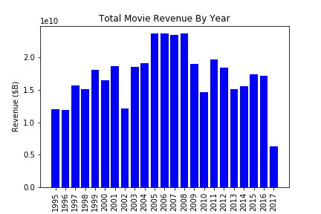
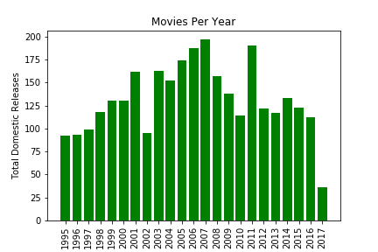
The movie industry hit it’s peak in 2008, and has not rebounded
Domestic movie revenue and total releases hit their peak in 2008, but both have been declining back to similar numbers seen in the 1990s
Current revenue and movie releases have remained relatively similar over the last 6 years
Key Considerations: Writer’s strike in 2008 and economic downturn

Slide 8
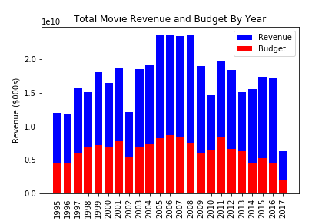
However, annual movie budgets have begun to decrease

Slide 9
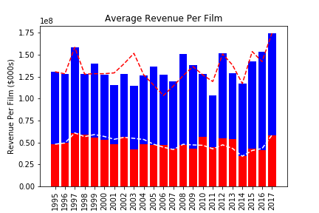
On a per-film basis, revenue has increased while budget stagnated

Slide 10
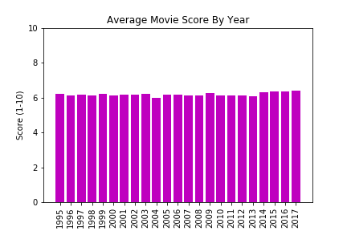
However, we overall movie ratings have barely changed!

Slide 11
Production Company Analysis 1

Slide 12
Production Companies 2

Slide 13
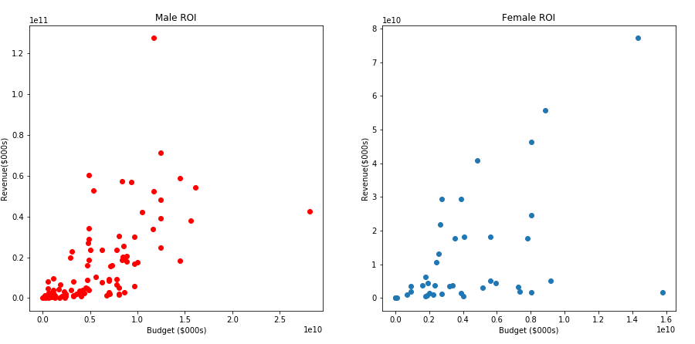
Based on lead actor, males have seen a higher ROI on budget

Slide 14
Key Takeaways
Sign documents.
Close the sale.

Slide 15
Looking forward

